Slide 1



Presentation V
Inverse Adding-Doubling Algorithm
Thu Ta Zaw
2415121095

Slide 2

Inverse Adding-Doubling Algorithm
IAD method is used to determine the intrinsic optical properties of scattering and absorbing materials by analyzing how light passes through them.
We can study the interaction of photons with biological tissues by analyzing the optical properties.
IAD uses an iterative, trial-an-error approach to solve the radiative transport equation.
The optical properties calculated from the algorithm are compared with measured value until they are in agree.

Slide 3
Inverse Adding-Doubling Algorithm
This simulation calculates how light would behave inside the material.
Firstly, measure the total reflection and transmission of a light beam from the sample.
The IAD repeatedly guess the optical properties of material (absorption, scattering coefficients and anisotropy factor).
It then simulates the expected reflection and transmission based on these guessed properties using the adding-doubling techniques.
This simulation results are compared against the initial, real-world measurement, and the algorithm refines its guesses for the optical properties until the simulated results closely match the experimental data.

Slide 4
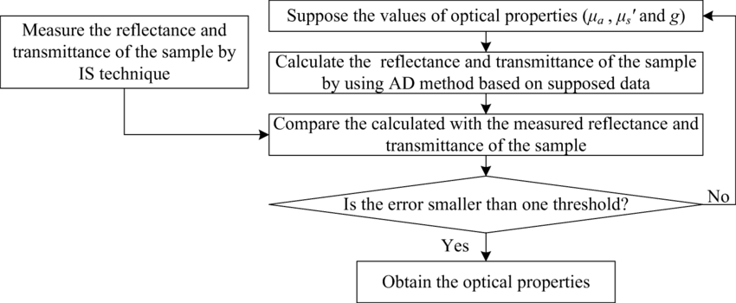
Procedure of IAD
Fig. Process Diagram of IAD

Slide 5
Monte Carlo Algorithm
MC simulation is an extensive class of computational algorithms that depends on repeated random sampling to obtain numerical results.
it mainly use numerical integration, optimization, and generating draws from probability distribution.
It is usually used to simulate light propagation in turbid materials under assumption of uniform macroscopic optical properties over the ranges of ultraviolet, Vis/NIR light.
It is valid for a wide range of absorption and scattering coefficients and photon paths.
It has high accuracy and slow computational time.
IAD is faster than MC with the same high accuracy.

Slide 6
Required List
NAME | PRICE
2-inch General-purpose Integrating Sphere [NIS-002-03A] | 140,000 Yen
Sphere cover for laser mount | 14,500 Yen
Sphere cover for detector mount | 12,500 Yen
Sample Holder
Baffle [light blocker] | Included
850 nm laser light | 4,000 Yen
HFCT sensor
Spectrometer | 77,702 Yen
Optical Fiber
Raspberry Pi 5 | N/A
GeeekPi Metal Case and N04 PCIe M.2 Key-M NVMe SSD PCIe Peripheral Board for Raspberry Pi 5 (Metal Case & Expansion Board & Active Cooling Fan) | 4,099 Yen
ElectroCookie 256GB NVMe SSD for Raspberry Pi 5 – SK OEM BC901 (2242 Size, PCIe Gen4 x4) | 4,399 Yen
Freenove 7-inch Touchscreen Monitor for Raspberry Pi 5, 4, B, 3, B+, A+, 800x480 Pixel IPS Display, 5-Point Touch Capacitive Screen, MIPI DSI Port with No Drivers | 7,280 Yen

Slide 7
The End
THANK YOU FOR LISTENING
Thu Ta Zaw
2415121095

